Slide 1
Scaling Learning to Rank to Big data
Parallel Learning to Rank Using Mapreduce
Niek Tax
Notes:
Hi everyone, my name is Niek Tax and in the next half an hour or so

Slide 2


Slide 3
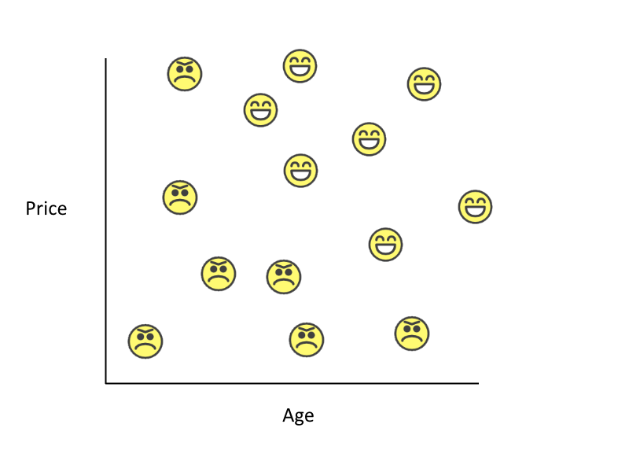

Slide 4
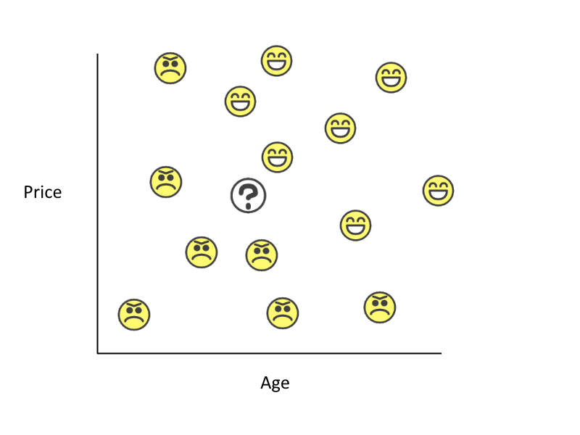

Slide 5
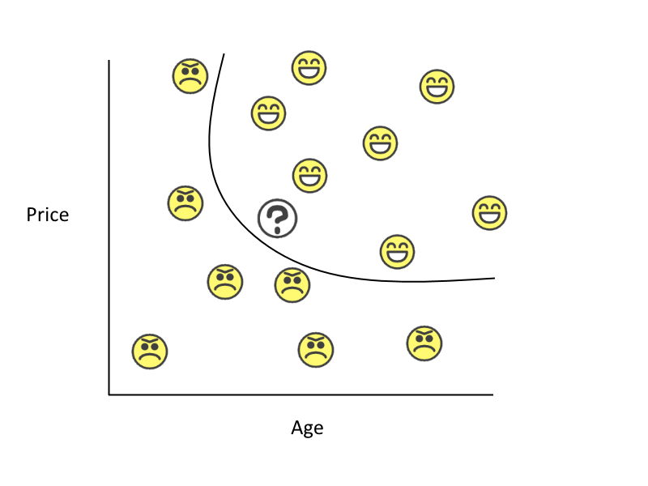

Slide 6
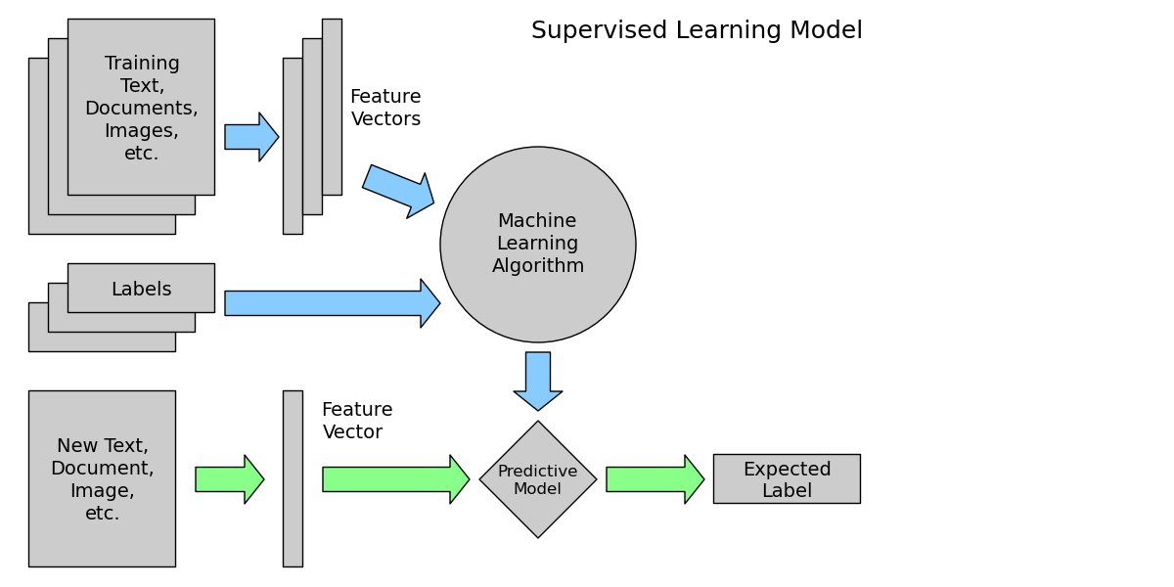

Slide 7
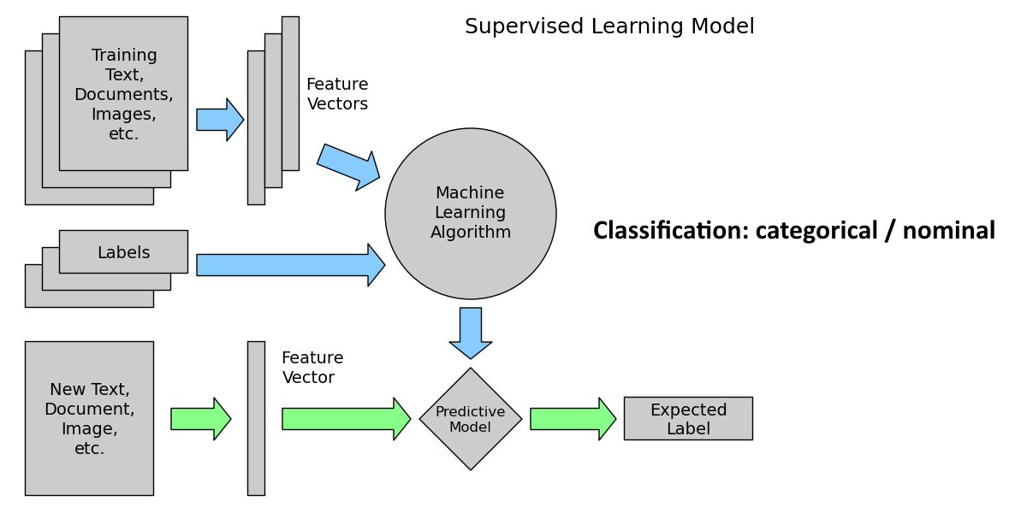

Slide 8
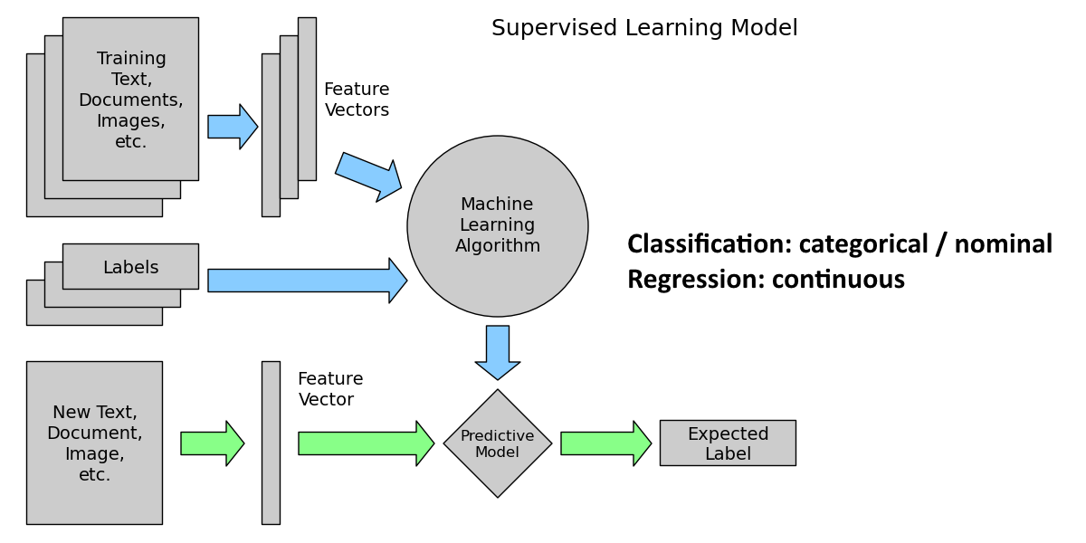

Slide 9
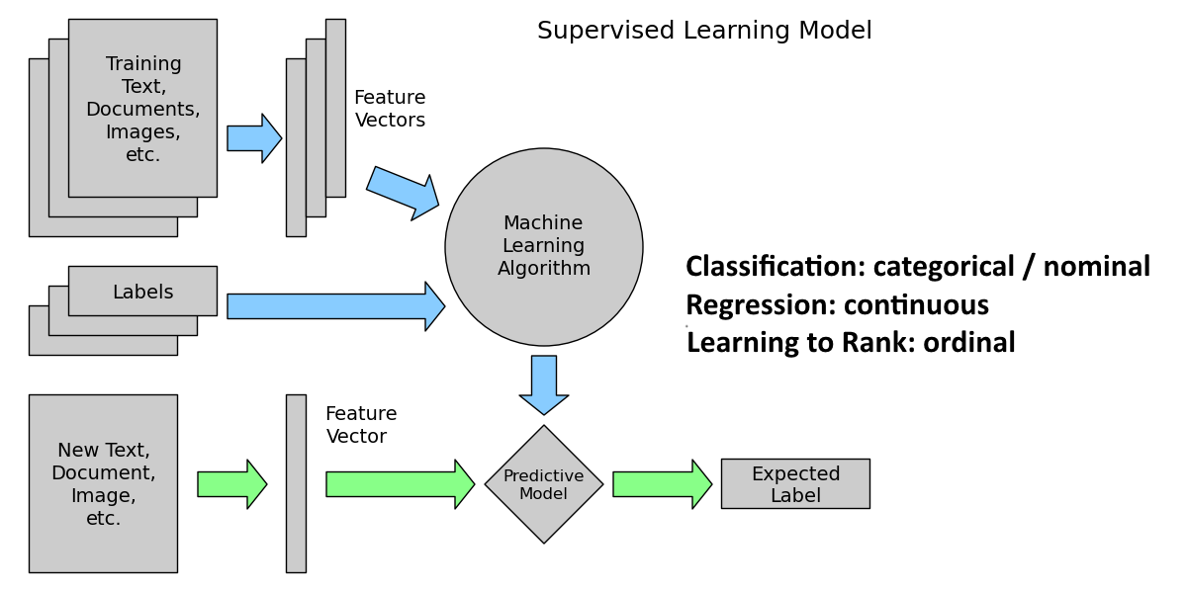

Slide 10


Slide 11


Slide 12


Slide 13


Slide 14


Slide 15


Slide 16


Slide 17
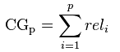
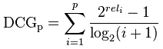
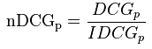
So… what makes a good ranking?
Normalized Discounted Cumulative Gain
Highly relevant documents are more useful than marginally relevant documents
Highly relevant documents are more useful when appearing higher in a search engine result list

Slide 18
Relevance Optimal
Label Rank
5 5
3 4
4 3
2 2
1 1

Slide 19
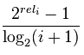
Relevance Optimal
Label Rank
5 5
3 4
4 3
2 2
1 1

Slide 20
Relevance Optimal
Label Rank
16.0 16.00
2.52 5.05
4.00 2.00
0.86 0.86
0.39 0.39

Slide 21
Relevance Optimal
Label Rank
16.0 16.00
2.52 5.05
4.00 2.00
0.86 0.86
0.39 0.39
23.77 24.30

Slide 22
Relevance Optimal
Label Rank
16.0 16.00
2.52 5.05
4.00 2.00
0.86 0.86
0.39 0.39
23.77 24.30
NDCG@5 = 23.77 / 24.30
= 0.978

Slide 23
Research question 1
What are the best performing Learning to Rank algorithms in terms of ranking accuracy on relevant benchmark data sets?

Slide 24


Many Benchmark datasets
LETOR 2.0
LETOR 3.0
LETOR 4.0
MSLR-web10/30k
Yahoo! Learning to Rank Challenge
Yandex Internet Mathematics Competition 2009
WCL2R
AOL

Slide 25
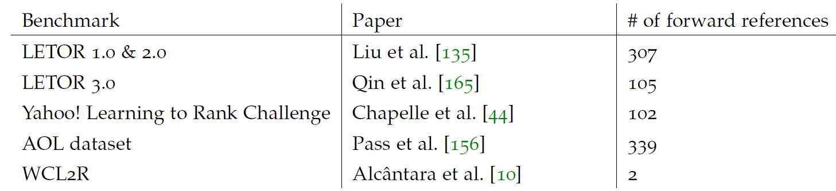
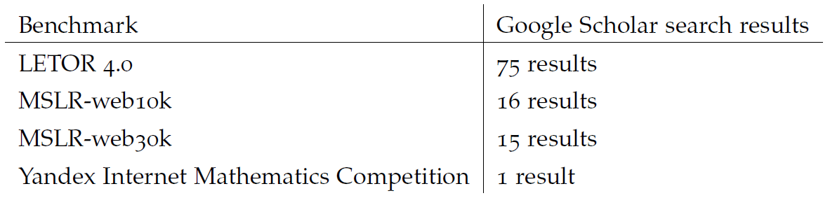
Search results

Slide 26
Literature filtering steps

Slide 27
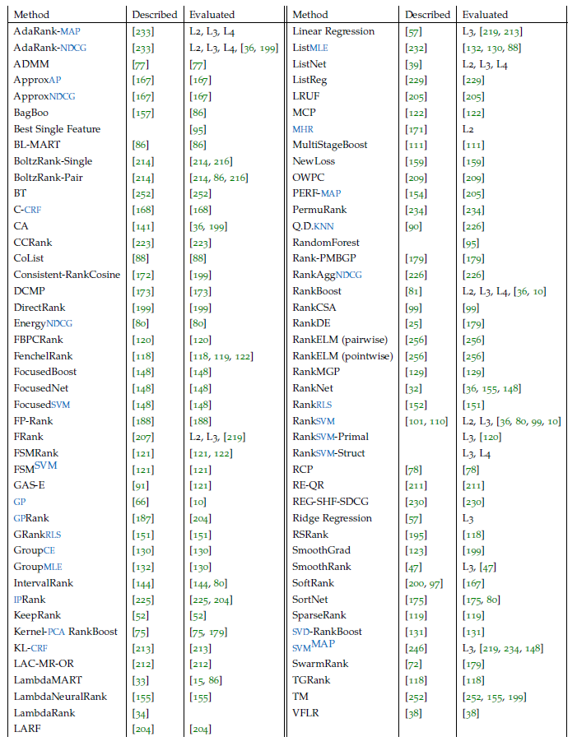

Slide 28
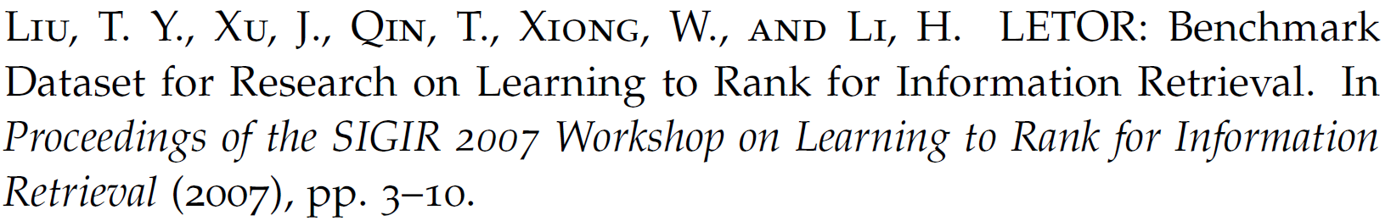
Comparison methodology
Winning Number (Liu et al., 2007)
Winning Number adapted for sparse evaluation sets:
Ideal Winning Number
Normalized Winning Number

Slide 29
Limitations
Possible bias in published evaluation runs
Relies on other researchers performing correct evaluations

Slide 30
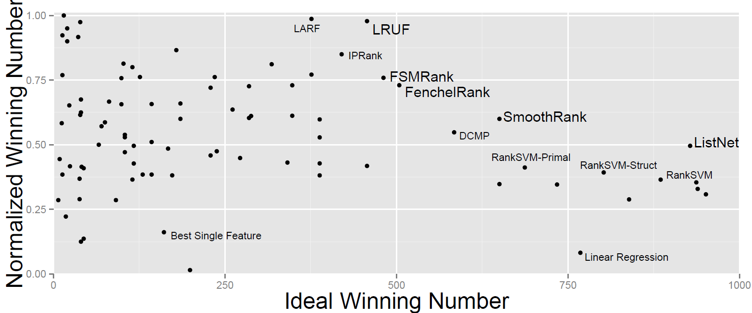
Comparison results

Slide 31
Research Question 2
What is the speed-up of those Learning to Rank algorithms when executed using the MapReduce framework?

Slide 32
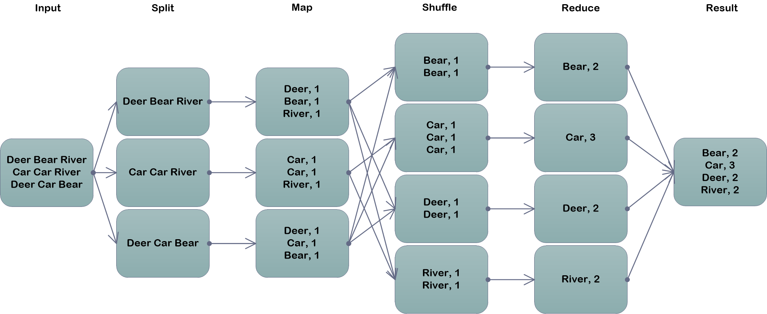
MapReduce

Slide 33
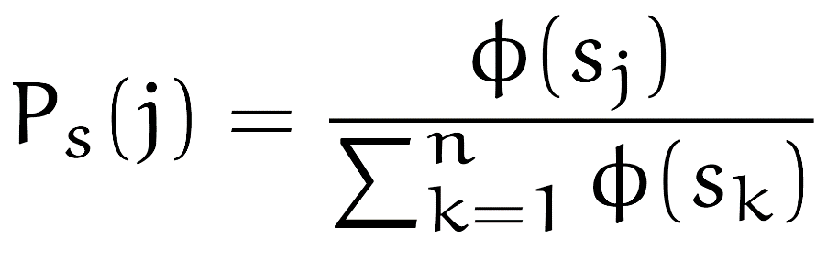
ListNet
Top-one probability:

Slide 34
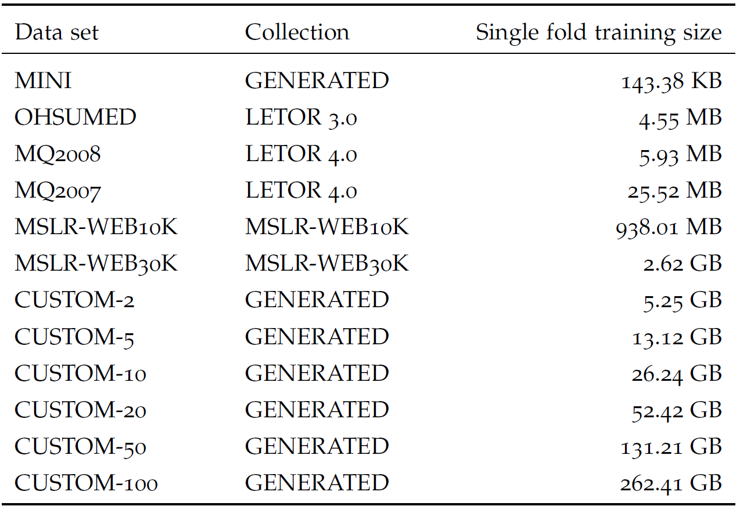
Data Sets

Slide 35
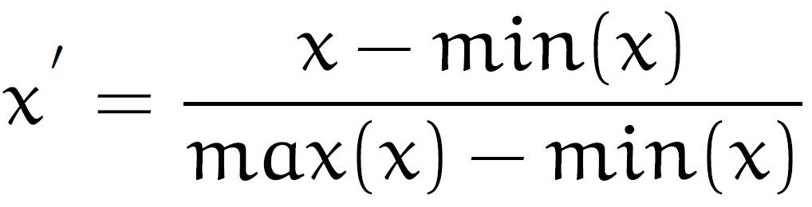
Preprocessing

Slide 36
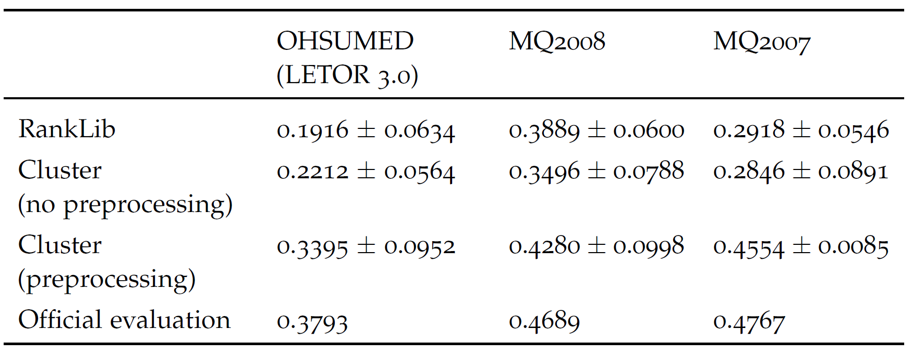
Preprocessing results

Slide 37
Convergence graphs

Slide 38
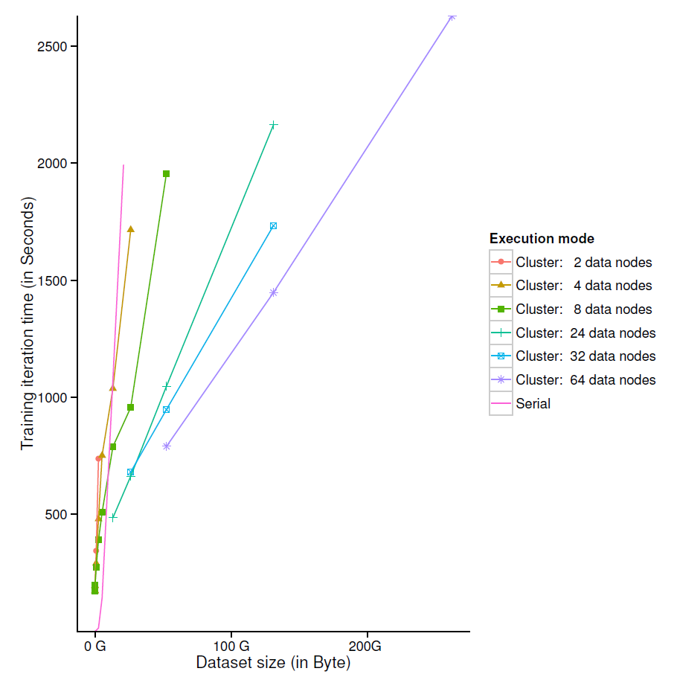

Slide 39
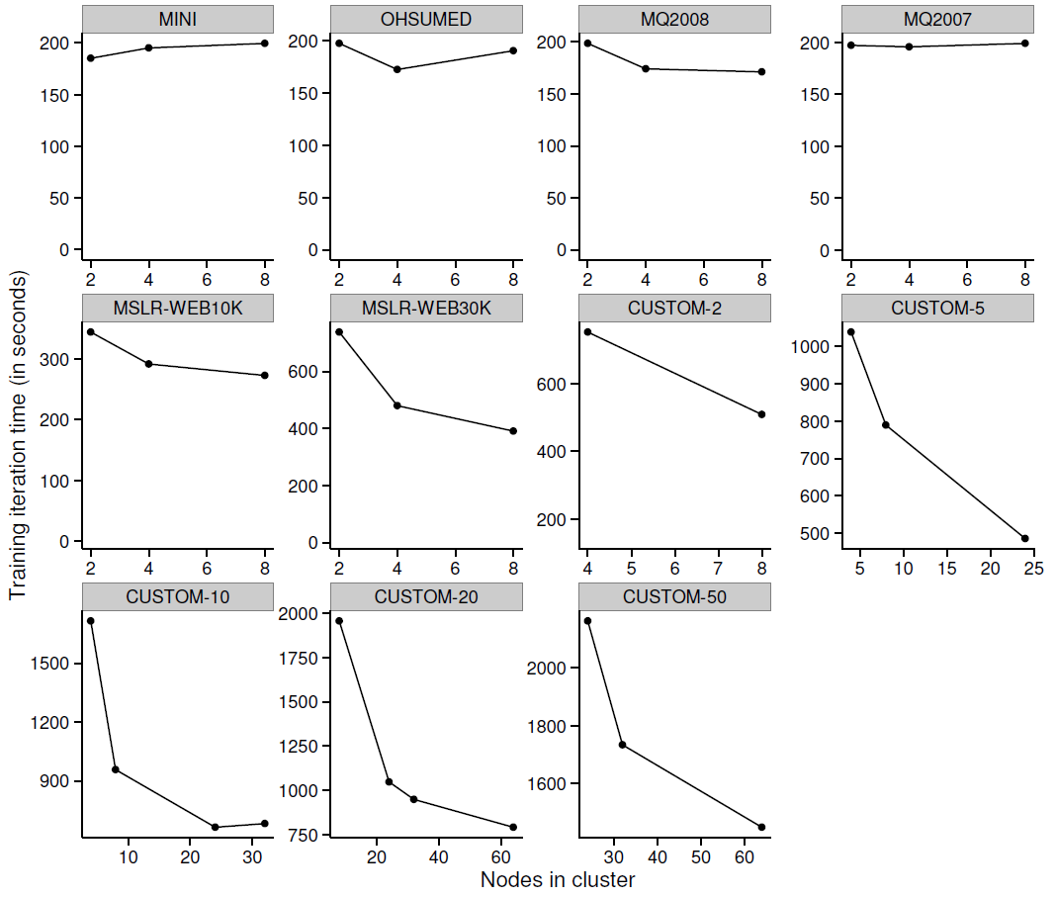

Slide 40
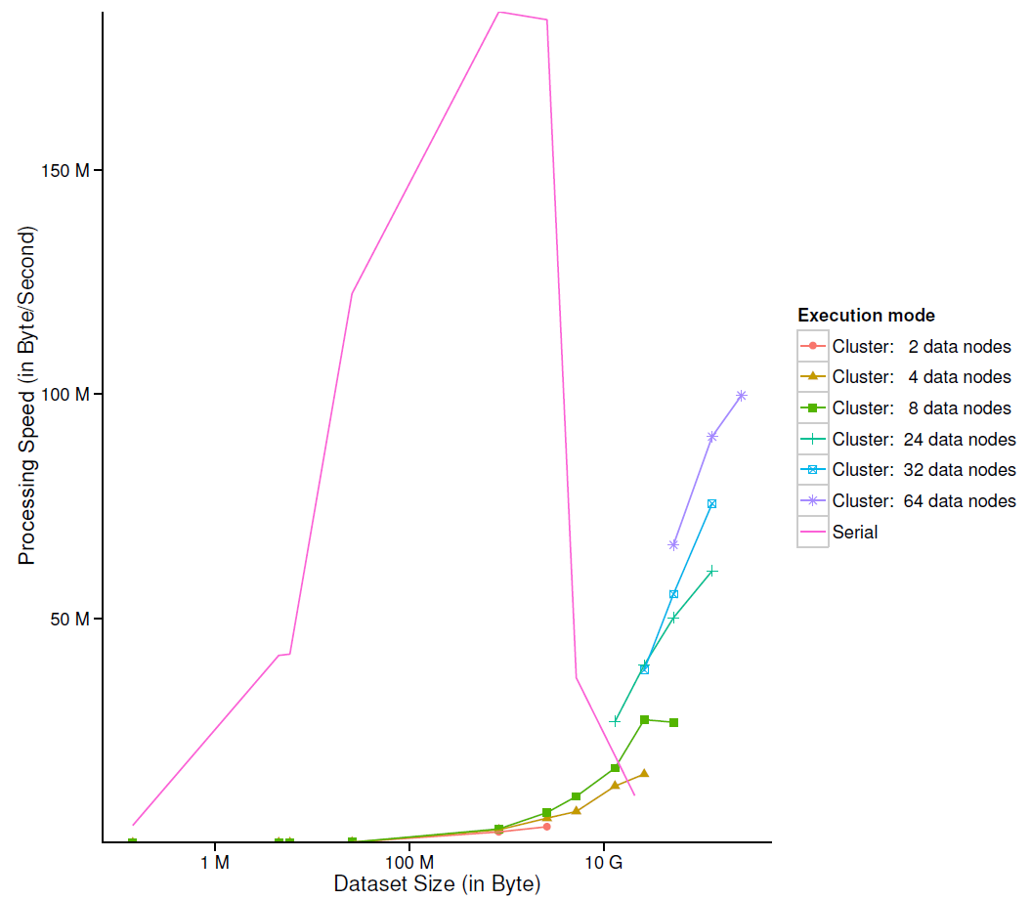

Slide 41
Conclusions & Contributions
New ranking algorithms comparison methodology
We found LRUF, FSMRank, FenchelRank, SmoothRank and ListNet to be the dominating Learning to Rank methods
High MapReduce job scheduling overhead: 150-200 seconds per iteration
Job scheduling overhead is independent of data set size
Single-machine ListNet does not scale well to data sets larger than physical memory
MapReduce can increase processing speed of data sets larger than physical memory
A normalisation preprocessing step improves the convergence rate of ListNet

Slide 42
Future work
Distributed computing models
Learning to Rank algorithms
Optimisation algorithms

Slide 43

Questions?

Slide 44
Question slides

Slide 45
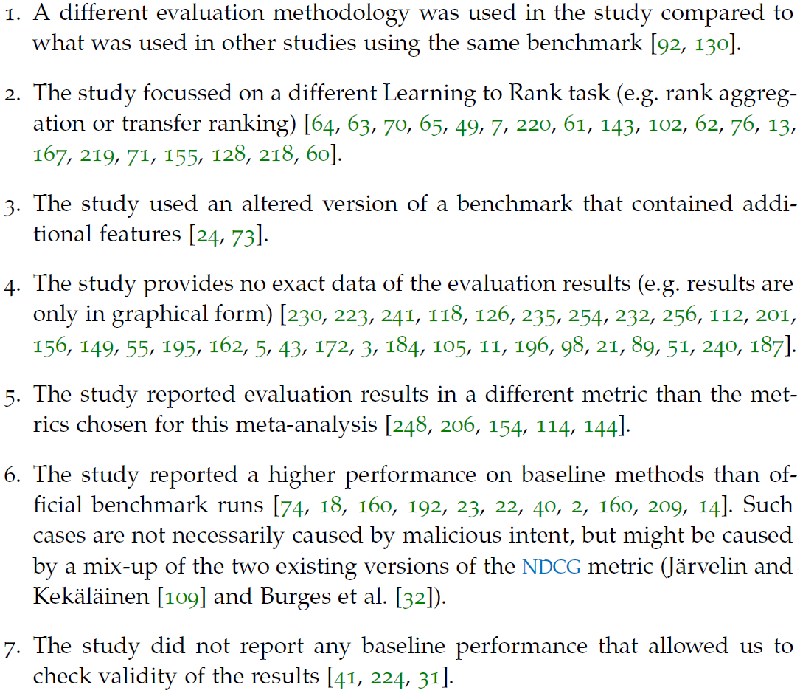
Literature filtering criteria

